Slide 1

ABSTRACT CLASSES

Slide 2
Background
Abstract classes are similar to interfaces.
We cannot instantiate them, and they may contain a mix of methods declared with or without an implementation
with abstract classes, we can declare fields that are not static and final, and define public, protected, and private concrete methods
With interfaces, all fields are automatically public, static, and final, and all methods that you declare or define (as default methods) are public
A class can extend only one class, whether or not it is abstract, whereas you can implement any number of interfaces

Slide 3
Background
we require just method declaration in super-classes
Abstraction can be achieved using abstract class and abstract methods
The abstract Method is used for creating blueprints for classes or interfaces
methods are defined but these methods don’t provide the implementation.
Abstract Methods can only be implemented using subclasses or classes that implement the interfaces.
a subclass must override them to provide a method definition

Slide 4
Points for Abstract Classes
Any class that contains one or more abstract methods must also be declared abstract.
If a class contains an abstract method it needs to be abstract and vice versa is not true.
if a non-abstract class extends an abstract class, then the class must implement all the abstract methods of the abstract class else the concrete class has to be declared as abstract as well.
Cannot use final, native, synchronized, static, private keywords with abstract classes

Slide 5
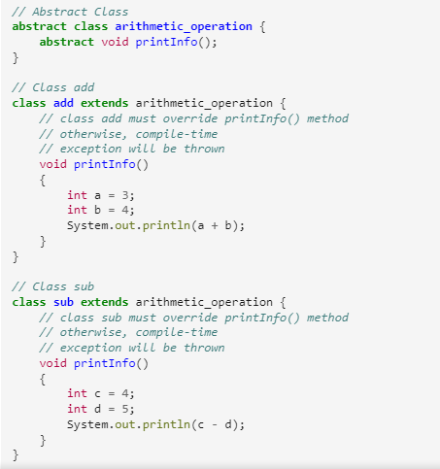

Slide 6
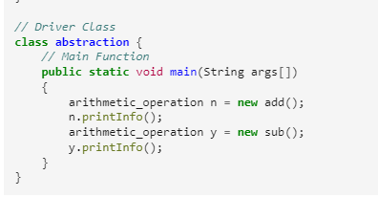
Main method

Slide 7
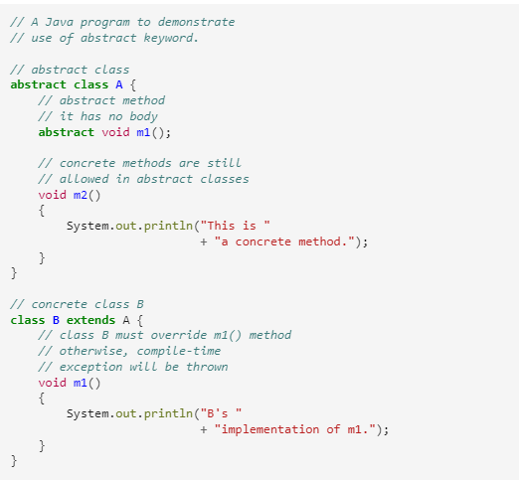

Slide 8
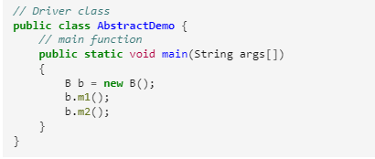

Slide 9
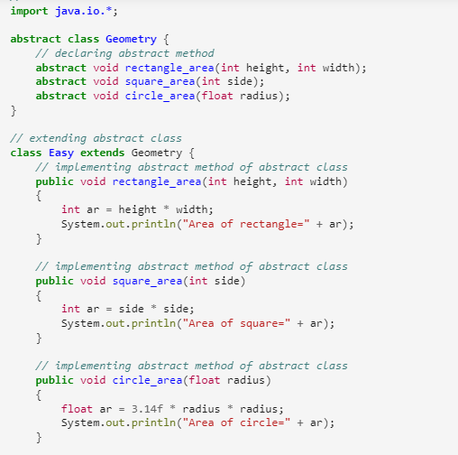

Slide 10
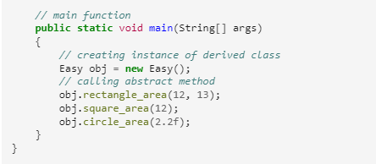

Slide 11
The End

